Slide 1
Various Applicated Adders
implementation
on Qiskit
and their performance
Team QAS
Challenge Topic 1 :
Build your minimal quantum circuit making a quantum calculator

Slide 2
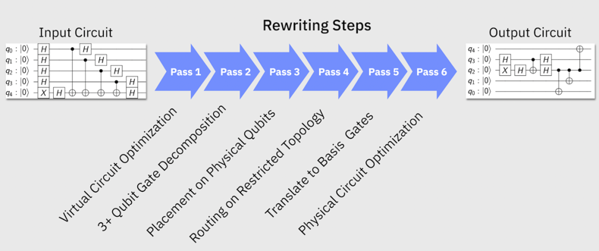

Slide 3
Adders we built
● Full Adder
● Ripple Carry Adder
● Quantum
Fourier Transfrom Adder
(QFT Adder)
4 versions
2 versions
Original
Changing ccx gate
Transpiler of (1)
Transplier of (2)
Original
Transpiler of (1)
Ripple Carry Adder
4 versions
(original, changing ccx gate, transpiler of each)

Slide 4
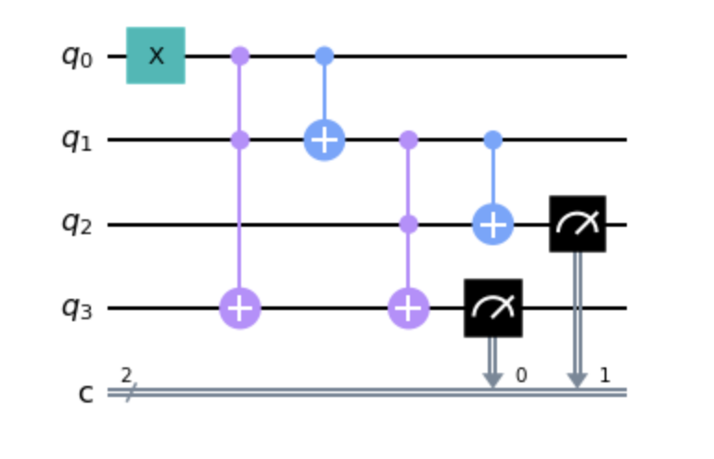
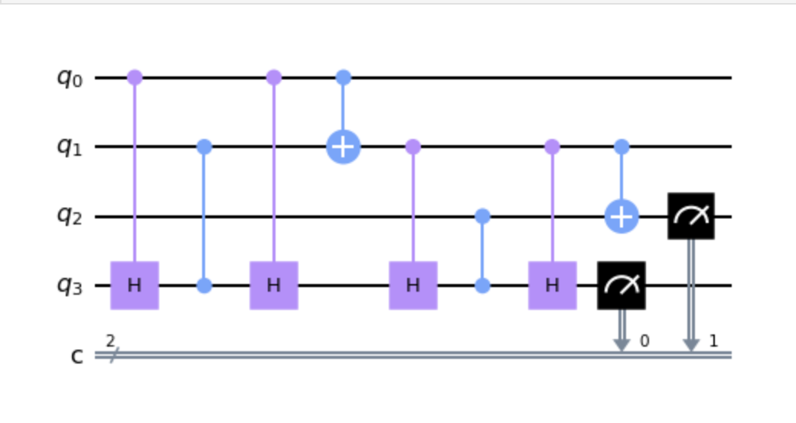
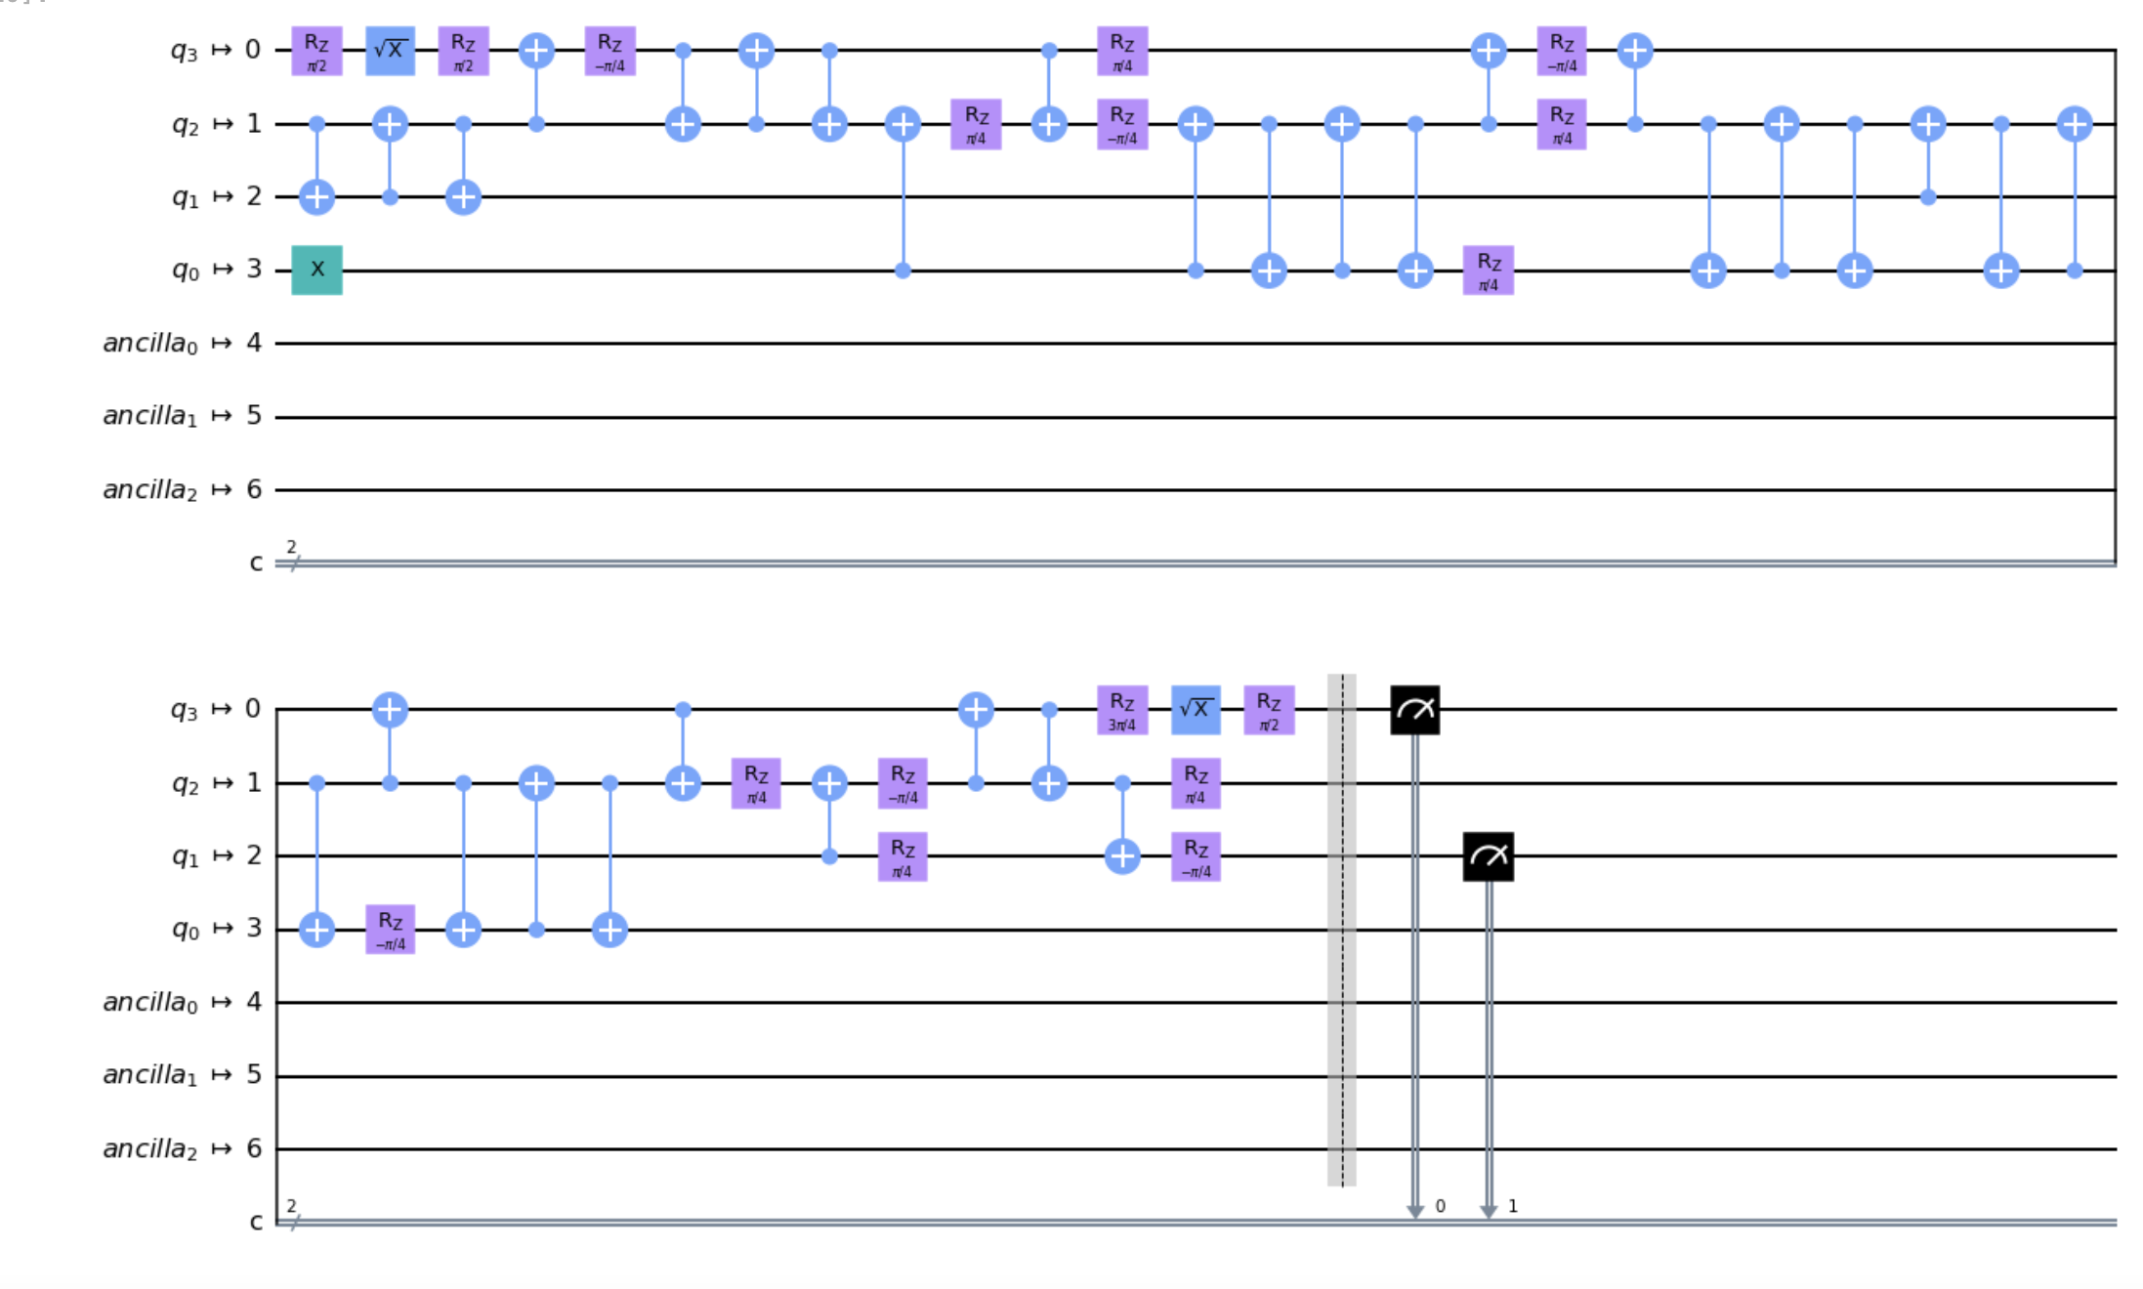
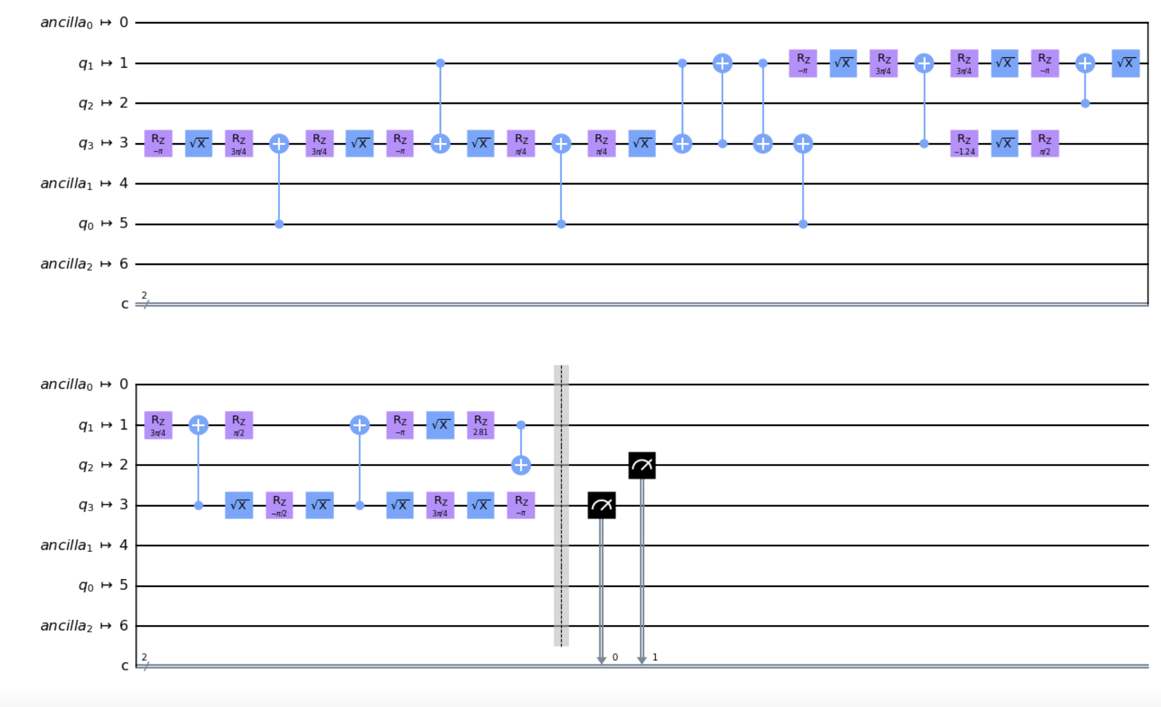
Result
CCX
1. Full
T
R
A
N
S
P
1. Original RCA
2. CCX changed RCA
I
L
E
4. Transpiled CCX Changed RCA
3. Transpiled Original RCA

Slide 5
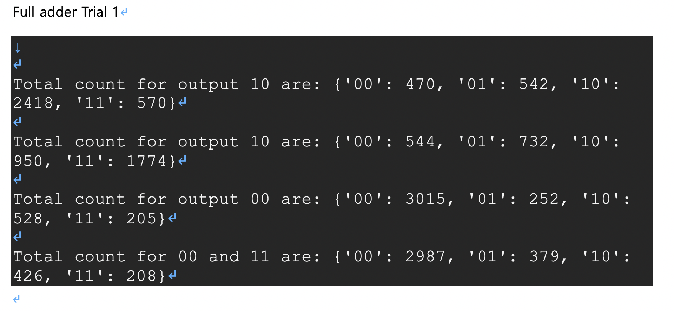
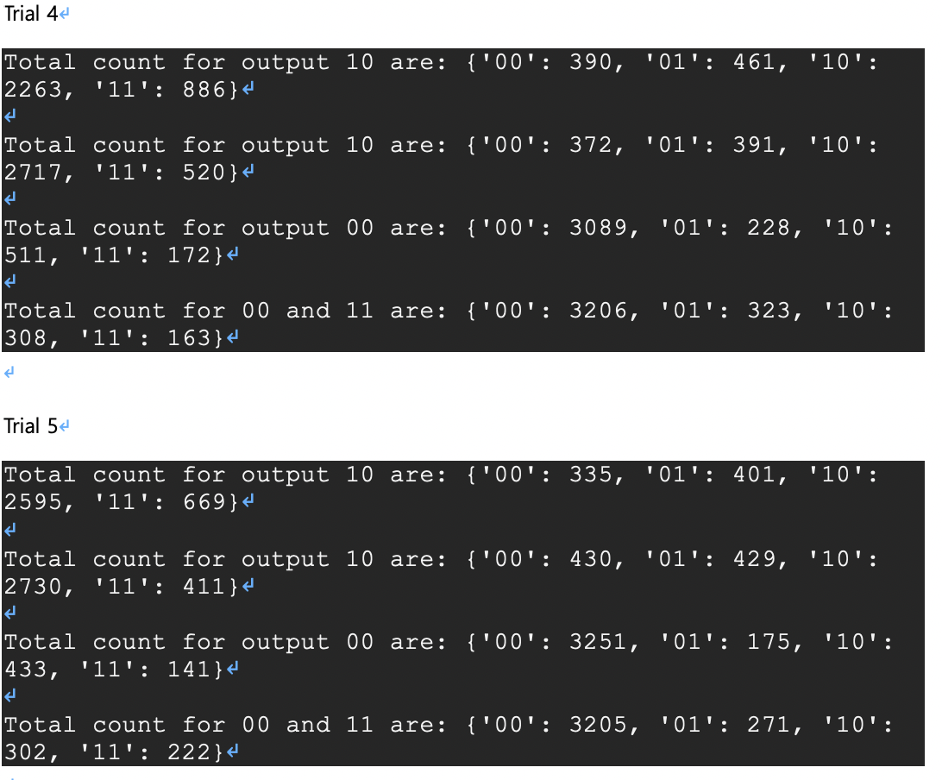
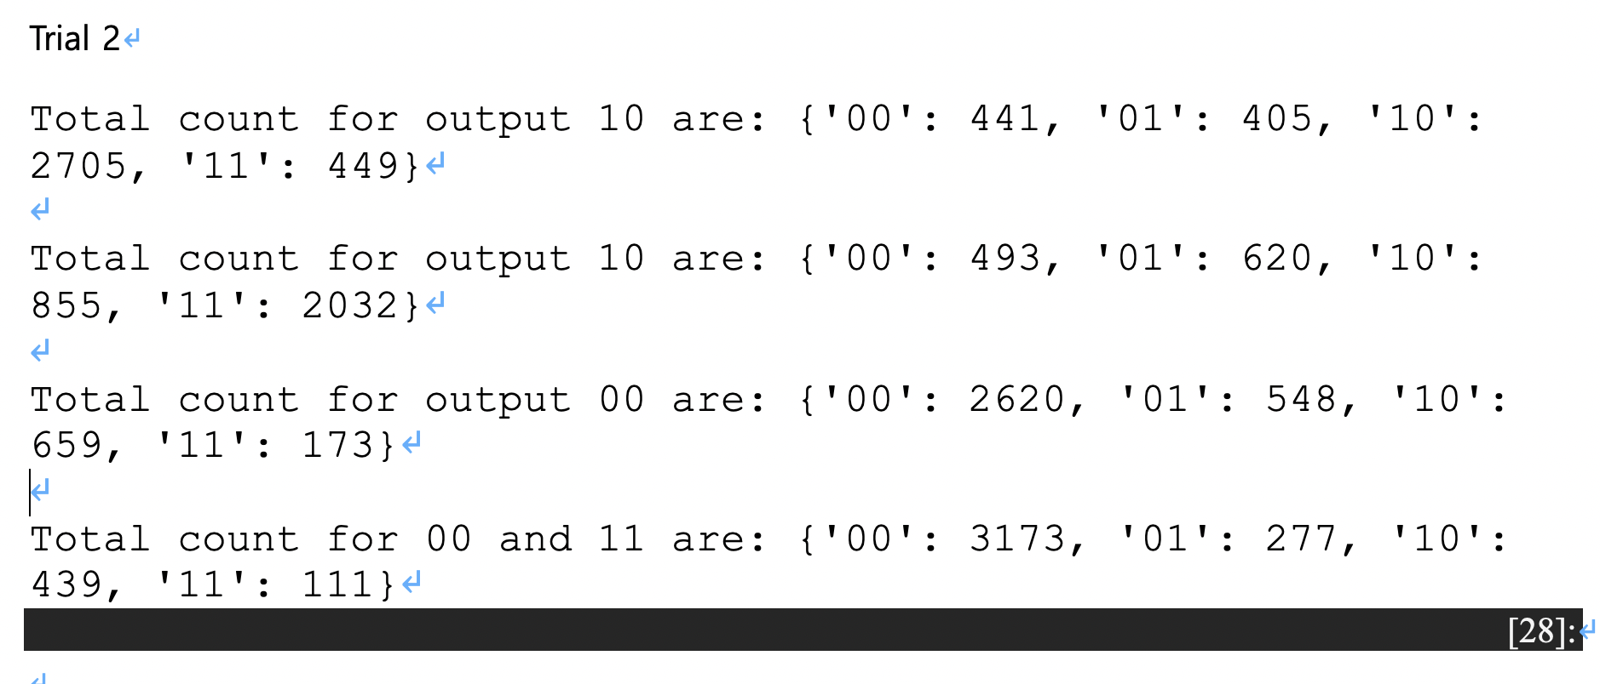
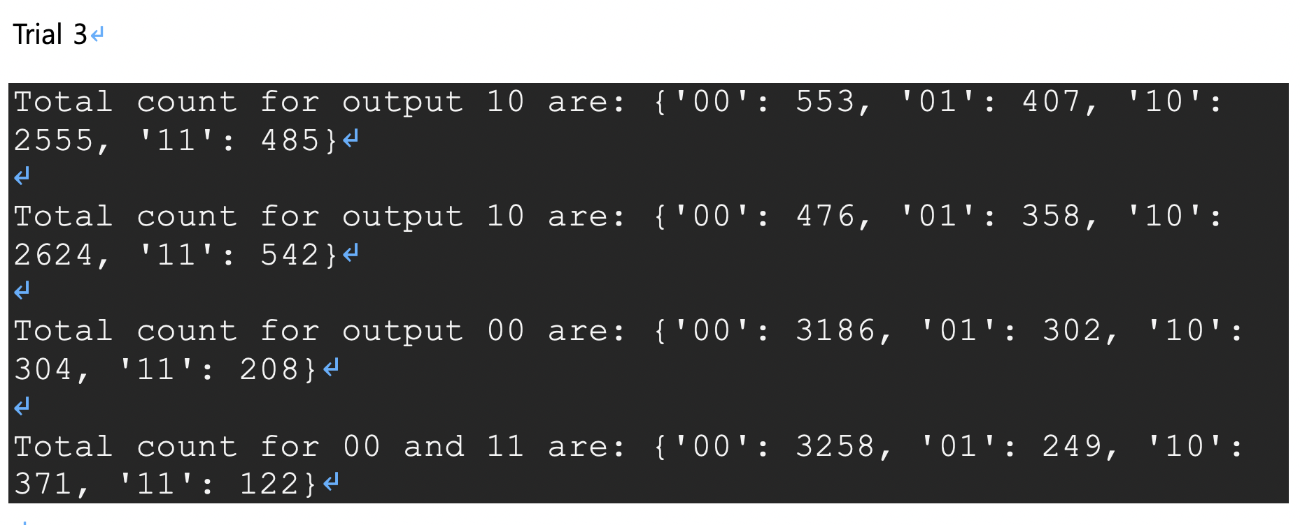

Slide 6
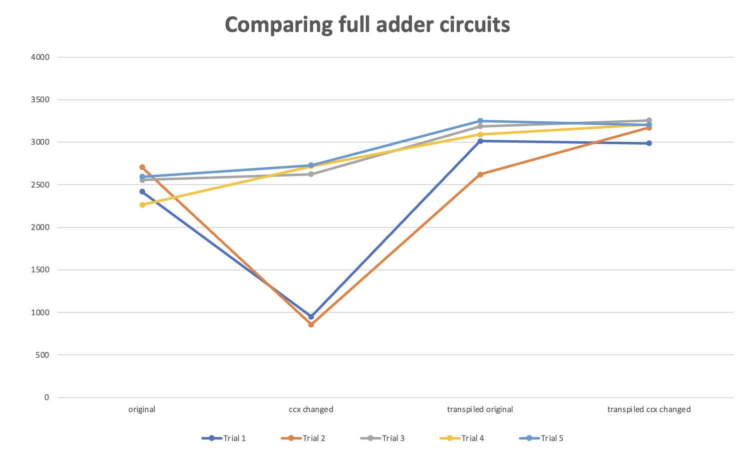

Slide 7
Result
CCX
2. Ripple-Carry
T
R
A
N
S
P
2. CCX changed RCA
1. Original RCA
I
L
E
4. Transpiled CCX Changed RCA
3. Transpiled Original RCA

Slide 8
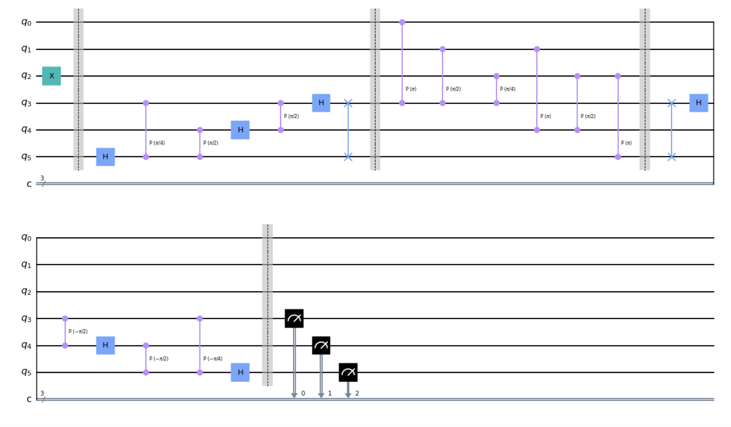
Result
3. Quantum Fourier Transform Adder
transpile
1. Original QFT Adder
2. Transpiled QFT Adder

Slide 9
What we have learned
Utilizing Qiskit
Transpiler
-How to use
-Transpiler vs Unroller
CCX gate -> CH-CZ-CH

